Slide 1
E-Commerce Cart using MongoDB

Slide 2
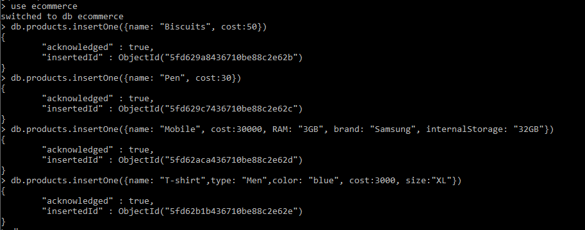
Creating Products collection and inserting objects into it.

Slide 3
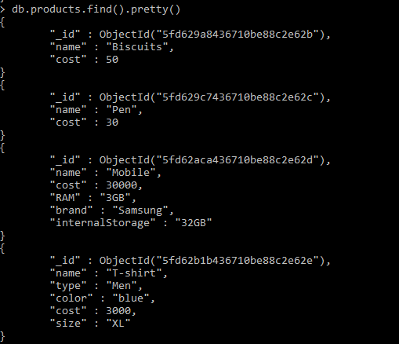
Displaying products

Slide 4
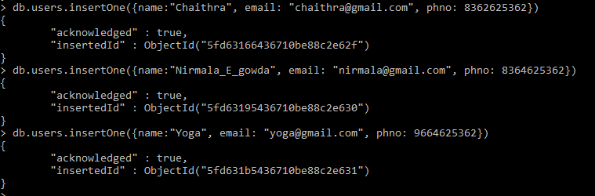
Creating users collections and inserting objects into it.

Slide 5
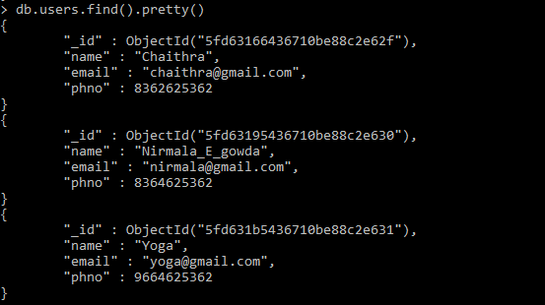
Displaying users data

Slide 6
Creating Cart collection to store products that user has kept in cart. One – Many relationship.

Slide 7
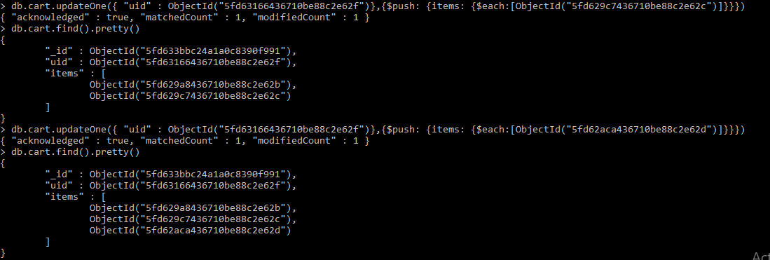
Appending products to the cart of an user (update).

